Slide 1
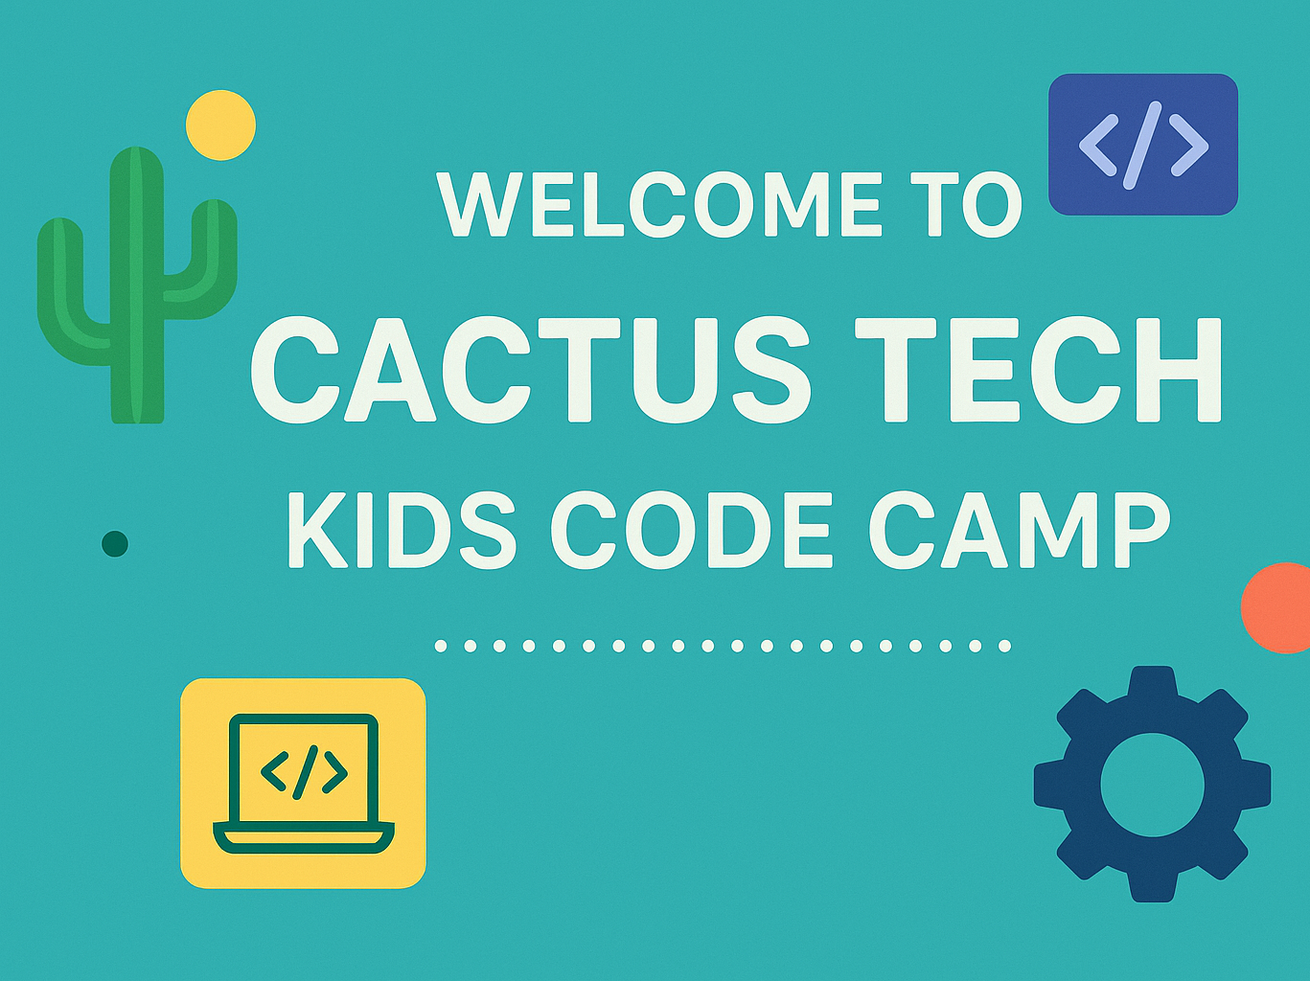

Slide 2
Let’s Learn Python! 🐍
Fun with coding step by step

Slide 3

What We’ll Learn Today
What Python is and why it’s awesome ✨
How to set up and run Python 💻
Using variables to store information 📦
Doing math and making decisions ➕➖
Repeating actions with loops 🔁
Organizing info with lists and more 📋
Writing our own mini functions 🛠️

Slide 4
What We’ll Learn Today
What Python is and why it’s awesome ✨
How to set up and run Python 💻
Using variables to store information 📦
Doing math and making decisions ➕➖
Repeating actions with loops 🔁
Organizing info with lists and more 📋
Writing our own mini functions 🛠️

Slide 5
What is Python? 🐍
A language computers understand
Easy to read like a storybook 📖
Used for: Making games 🎮, Websites 🌐, Robots 🤖, Science 🧪

Slide 6

Setting Up Python 🖥️
Install Python from python.org ✅
1
Use a code playground like IDLE or VS Code 🎨
2
Type this to say hello:
3
print("Hello, World!")
4

Slide 7
Assignment
Using the print command in Python, print :
  Your name
  Your favorite food
  Your best friend
  Your favorite hobby
  Your favorite song
Hint: I should see 5 print statements

Slide 8
Python Words & Boxes (Variables) 📦
Indentation is like neat handwriting 🖋️
# is for notes ✏️
Variables are boxes that hold stuff!
Types: numbers, words, true/false
Example: name = "Lily"; age = 10; is_student = True

Slide 9
Python Variables📦
By the end of this lecture, students will be able to:
  Define what a variable is and why variables are important in programming
  Create and assign values to variables in Python
  Understand Python's dynamic typing system
  Use proper variable naming conventions
  Work with different data types through variables
  Perform basic operations with variables

Slide 10
What is a Variable?
Think of a variable as a labeled container that holds data in your computer's memory. Just like you might put your lunch in a container labeled "lunch" in the refrigerator, you can store data in a variable with a meaningful name.
In programming, variables allow us to:
Store information for later use
Give meaningful names to our data
Change values as our program runs
Make our code readable and reusable

Slide 11
Real World Analogy
Imagine variables like labeled boxes in a warehouse:
The label is the variable name (like student_name)
The contents are the data/value (like "Alice")
You can change what's in the box, but the label stays the same

Slide 12
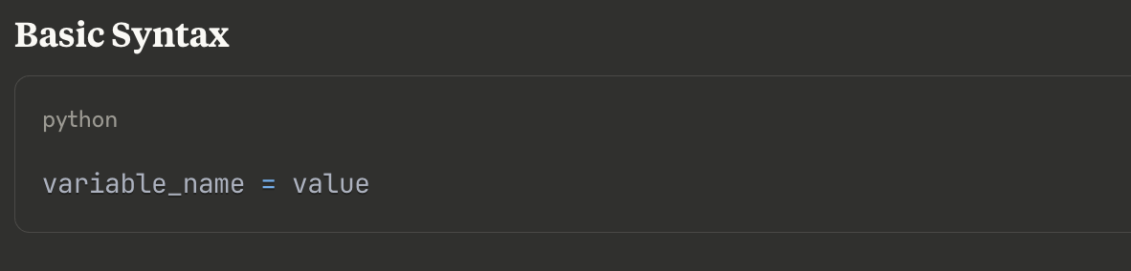
Creating Variables in Python

Slide 13
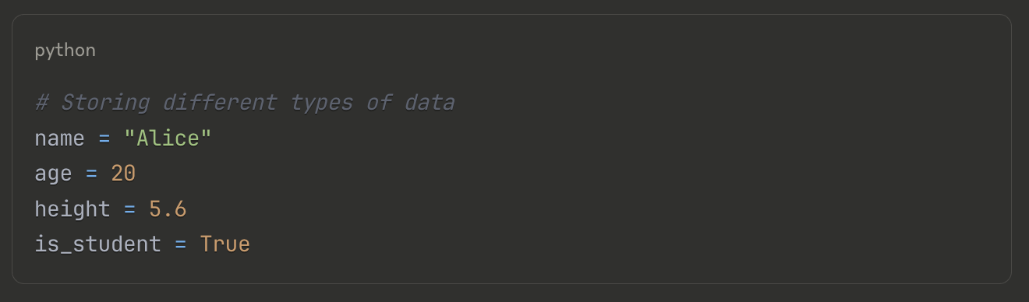
Examples

Slide 14
Examples
Key Point: The = sign is the assignment operator, not "equals". It means "store the value on the right into the variable on the left."

Slide 15
Examples
Key Point: The = sign is the assignment operator, not "equals". It means "store the value on the right into the variable on the left."

Slide 16
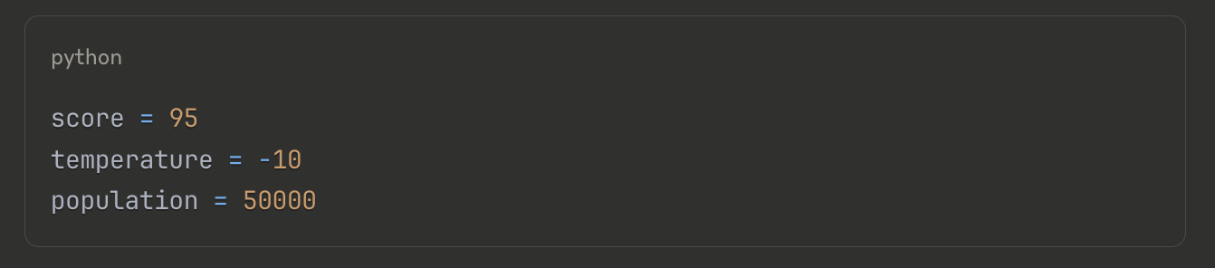
Common Data Types in Python
Integers
  Whole numbers, positive or negative

Slide 17
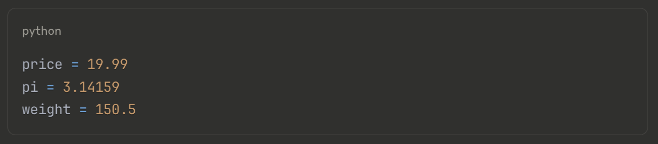
Common Data Types in Python
Floating-Point Numbers (float)
  Numbers with decimal points

Slide 18
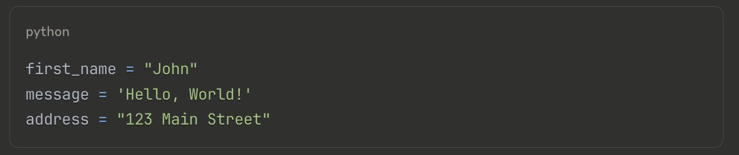
Common Data Types in Python
String
  Text data, enclosed in quotes

Slide 19
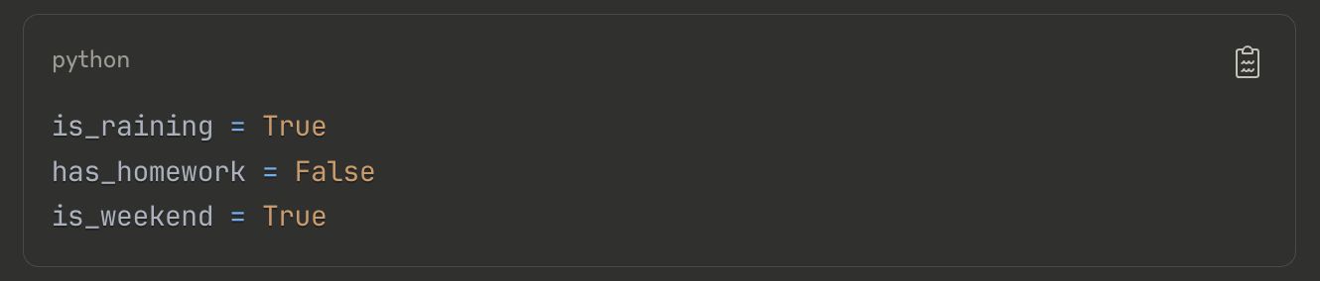
Common Data Types in Python
Booleans
  True or False values

Slide 20
Variable Naming Rules and Conventions
Must start with a letter (a-z, A-Z) or underscore (_)
Can contain letters, numbers, and underscores
Cannot contain spaces or special characters (@, #, $, etc.)
Case-sensitive (name and Name are different variables)
Cannot use Python keywords (like if, for, while)

Slide 21
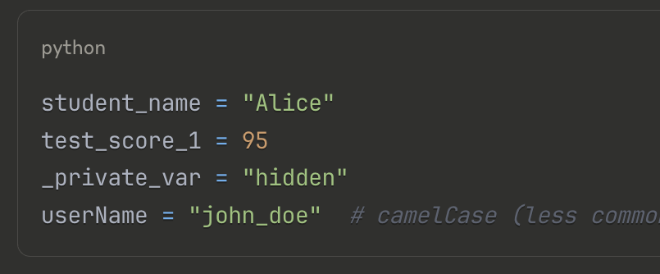
Good Examples

Slide 22
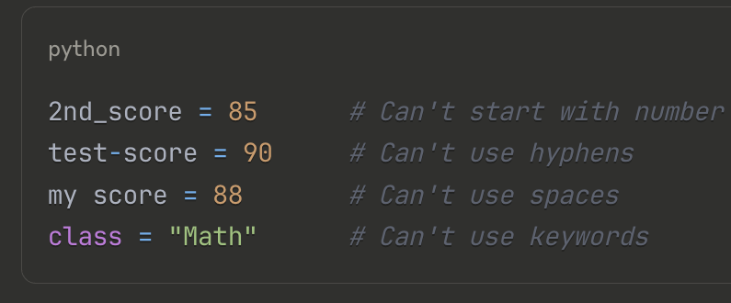
Bad Examples

Slide 23

Variable Naming Conventions
Use
Use lowercase with underscores for variable names (snake_case)
Use
Use descriptive names that explain what the variable stores
Avoid
Avoid single letters except for temporary counters

Slide 24
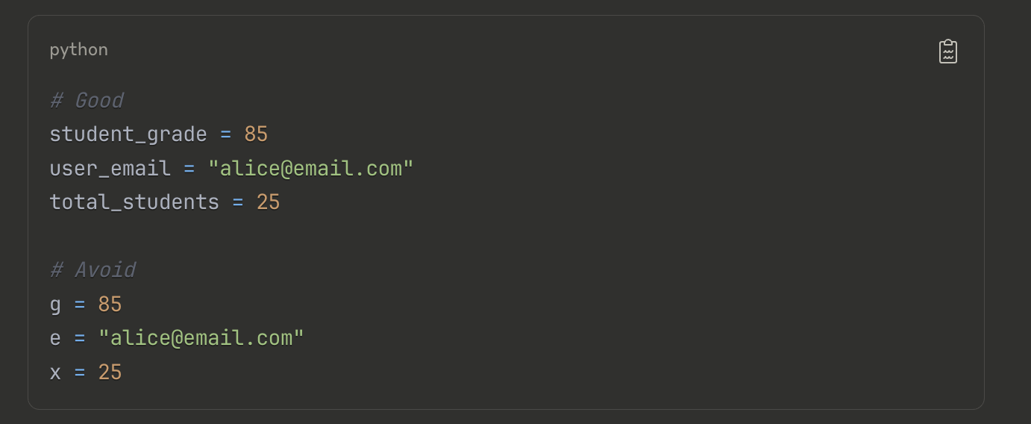
Variable Naming Conventions

Slide 25
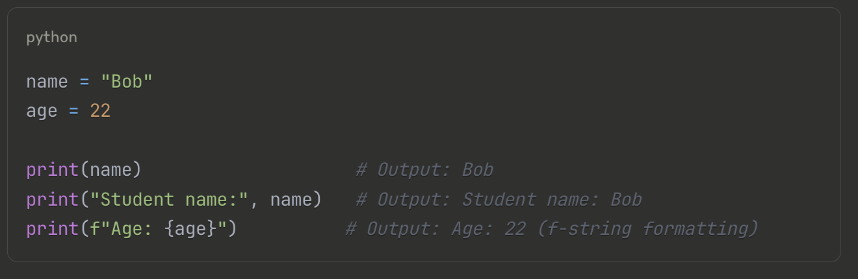
Displaying Variable

Slide 26
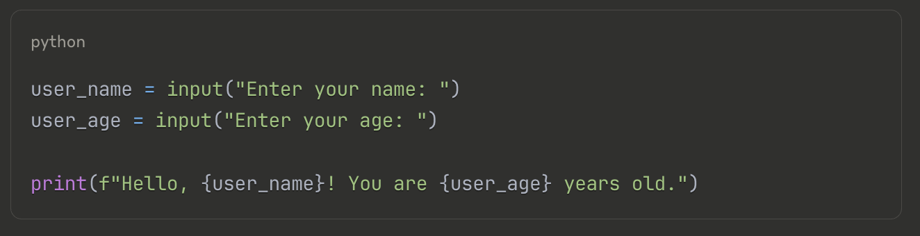
Getting User Input

Slide 27
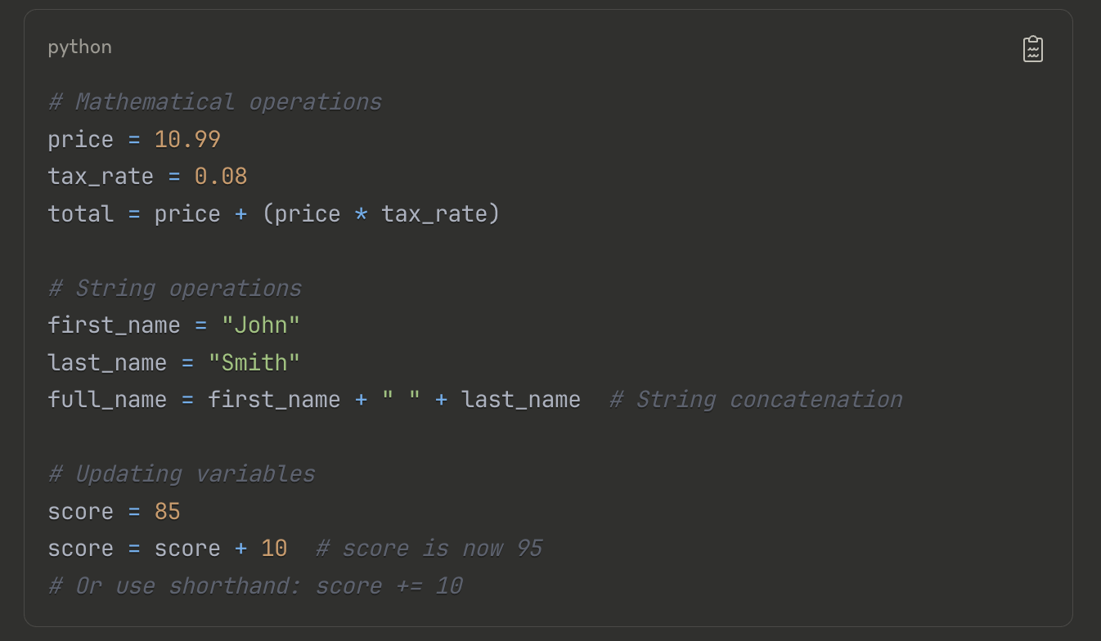
Using Math Operators

Slide 28
Getting User Input

Slide 29
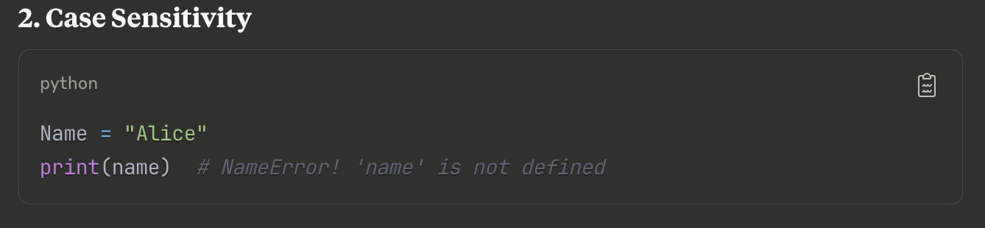
Common Mistakes and How to Avoid Them

Slide 30
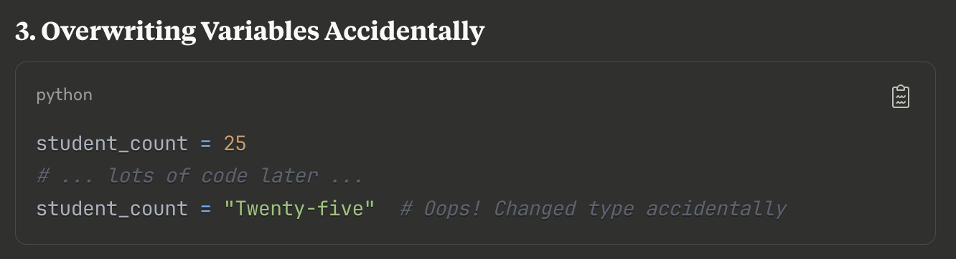
Common Mistakes and How to Avoid Them

Slide 31
Practice Exercise 1
Exercise 1: Basic Variable Creation
Create variables to store:
Your favorite movie (string)
The year it was released (integer)
Your rating out of 10 (float)
Whether you'd recommend it (boolean)

Slide 32
Practice Exercise 2
Exercise 2: User Information
Write a program that:
Asks the user for their name, age, and favorite color
Stores these in appropriately named variables
Prints a personalized message using all three pieces of information

Slide 33
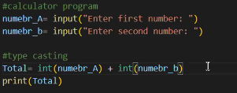
Assignment
Exercise 3: Simple Calculator
Create variables for two numbers and:
Calculate and store their sum, subtraction, multiplication, and division
Display the results in a formatted way

Slide 34
Key Takeaways
Variables are containers for storing data with meaningful names
Use descriptive names following Python naming conventions
Variables can change values and types during program execution
Always define variables before using them
Case matters - name and Name are different variables

Slide 35
Great Job! 🎉
Python is fun and friendly 🐍
You learned variables and data types today 🌟
Keep exploring and making cool stuff! 💡

